Slide 1
A Study Of The Book Of Revelation
October 10, 2021

Slide 2
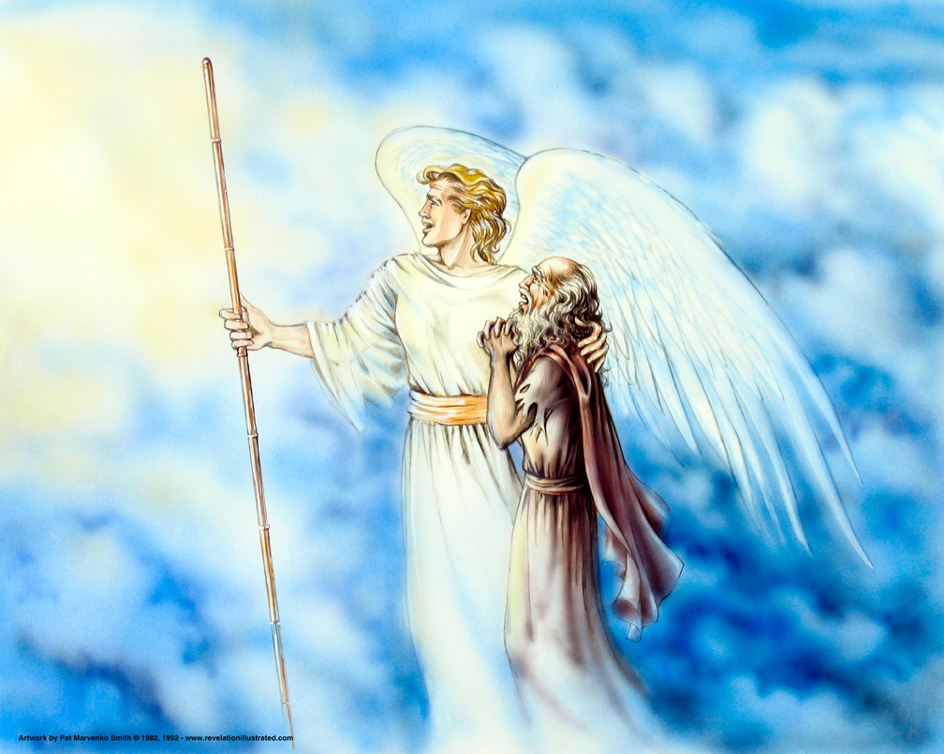
The Book of Revelation: Chapter 21
Revelation 21
The New Jerusalem!

Slide 3
Revelation 21
“The 1901 American Standard Bible has as its subtitle for Revelation 21, ‘The Consummation.’ The idea of
fulfillment and completion is depicted in the revelation of heaven’s identity. The Apostle John sees far into the
future. John sees a day when all humanity is raised, judged, and sent to their eternal abode. Satan and his demonic
forces have been cast into hell. All that the saints had been promised and ever hoped for now comes to pass. At the
point of the consummation the saints may finally have their promised rest (Heb. 4:1). The horrid battles against
worldliness and false teaching will be over for ever. Satan’s reign of terror ends. The saints shall now reign forever
and eternally dwell in the presence of Jehovah God.”
(Revelation by John Robertson, PDF file, page 90)

Slide 4

Revelation 21:1
Revelation 21
“And I saw a new heaven and a new earth: for the first heaven and the first earth are passed away; and the sea is no more.”

Slide 5
Revelation 21:2
Revelation 21
“And I saw the holy city, new Jerusalem, coming down out of heaven of God, made ready as a bride adorned for her husband.”
Revelation 19:7-8

Slide 6
Revelation 21:3
Revelation 21
“And I heard a great voice out of the throne saying, Behold, the tabernacle of God is with men, and he shall dwell with them, and they shall be his peoples, and God himself shall be with them, (and be) their God:”

Slide 7
The New Jerusalem
Revelation 21
Christians of all ages love to read about the future abode of the saints.
How much would this be comforting to the suffering saints of the 1st century?
Other questions have been answered:
Why is the tribulation taking place?
How long will it last?
What will be the final outcome?

Slide 8
The New Jerusalem
Revelation 21
A “new heaven and new earth”
This is not a renovation but a new order
Isaiah 34:3-5 – End of the nations.
Isaiah 51:4 – End of the Jewish order, Jerusalem.
Isaiah 51:16 – Planting of a new heaven and earth.
Isaiah 65:16-17, 25 – Fulfilled in the reign of Christ.
“First heaven and first earth had passed away.”
2 Peter 3:7-13; Revelation 21 – New order beyond the Judgment.
Different kind – a complete transformation!
This new heaven and earth will be clean and undefiled for the permanent dwelling place of those who have overcome the wiles of the devil during their lifetime.

Slide 9
The New Jerusalem
Revelation 21
“No more sea”
Sea of glass mentioned earlier separated God from His servants (4:6) is now removed.
The sea has been symbolic of the masses of humanity (Isaiah 57:20; 13:1; 20:13).
The masses have now been judged and are no more.
Fellowship with God restored!
This new Jerusalem (church or assembly of saints judged righteous) is now presented to the Lord as a perfect bride with no blemishes of sin. (cf. Ephesians 5:25-27)

Slide 10
The New Jerusalem
Revelation 21
“John saw the holy city, New Jerusalem!”
God’s people of all time periods, angels compromise this city
Hebrews 11:10, 13-16
“Coming down out of heaven”
Origin of this city comes from God
Born from above – John sees in a vision
“Prepared as a bride adorned for her husband ” cf. Revelation 19:7-8
Dressed in spotless white, purity
Men and women have been transformed into a character of godliness, cleansed, and sanctified

Slide 11
Tabernacle With God
Revelation 21
Uninterrupted fellowship and total union with God.
The word tabernacle means “dwelling place.”
When the new Jerusalem appears, the Lord shall dwell with His people. They shall “see his face” (cf. Revelation 22:4; 1 John 3:2).
For the first time in the history of mankind the saints shall see the Lord’s face (cf. John 1:18).
All distance between God and His people has been removed
In the immediate presence of God
Not just temporarily but forever
John 1:14

Slide 12
Revelation 21:4
Revelation 21
“and he shall wipe away every tear from their eyes; and death shall be no more; neither shall there be mourning, nor crying, nor pain, any more: the first things are passed away.”

Slide 13
Former Things Gone
Revelation 21
Such a picture overwhelms the imagination
Life in heaven has no inadequacies or unsatisfied needs of any sort
Death is forever destroyed
Sorrow gone – replaced with joy
Crying ceases – no more oppression
Pain/suffering ceases – no more anguish
“Former things” are passed away!
The beauty of heaven is the absence of Satan. The horrors of hell is the absence of God.

Slide 14
Revelation 21:5
Revelation 21
“And he that sitteth on the throne said, Behold, I make all things new. And he saith, Write: for these words are faithful and true.”

Slide 15
All Things New
Revelation 21
“He that sitteth on the throne” has been identified as Jesus and/or God (cf. Revelation 3:21; 20:11).
The new replaces the old. The old was subject to corruption, death, and sin.
The new is immune from death, corruption, and sin because they have all been thrown into the lake of fire and are no longer a factor in the reigning bride of Christ (Revelation 20:13-15).

Slide 16
Revelation 21:6
Revelation 21
“And he said unto me, They are come to pass. I am the Alpha and the Omega, the beginning and the end. I will give unto him that is athirst of the fountain of the water of life freely.”

Slide 17
Rivers of Living Water
Revelation 21
As in the past (Isaiah 12:3; 55:1) and present (John 4:10ff; 7:37-38) rivers of living water represent the abundant salvation offered in the Lord.
The new order, after the consummation, will also have rivers of living waters representing man’s eternal salvation (see Revelation 22:1).
All who, throughout their lives, hunger and thirst for righteousness will be filled (see Matthew 5:6).

Slide 18
Revelation 21:7
Revelation 21
“He that overcometh shall inherit these things; and I will be his God, and he shall be my son.”

Slide 19
Divine Assurance
Revelation 21
“Overcometh” (nikao) (used seventeen times in Revelation) is “come off victorious: of Christians, that hold fast their faith even unto death against the power of their foes, and their temptations and persecutions” (Thayer, page 426).
NOTE: All the letters to the seven churches of Asia closed with special promises to the overcomers (2:7, 11, 17, 26; 3:5, 12, 21).
God instructed John to write these things were true and dependable
“Alpha and Omega” – “beginning and the end ”
He fulfills His promises

Slide 20
Divine Assurance
Revelation 21
Salvation is a gift of God – all who thirst can freely drink (22:17)
Forces none to drink
The Faithful, those who overcome, will inherit theses things and God will be their Father!

Slide 21
Divine Assurance
Revelation 21
The victorious saint shall inherit the new heavens, earth, and Jerusalem.
Here is everlasting life (cf. Matthew 19:29; 25:34).
True sons of God, the elect, those who loved not their lives unto death shall inherit God’s eternal promised blessings (cf. Ephesians 1:13- 14; Galatians 3:26).
This is the message of the book of Revelation! Revelation 17:14, “These shall war against the Lamb, and the Lamb shall overcome them, for he is Lord of lords, and King of kings; and they (also shall overcome) that are with him, called and chosen and faithful.”
Those who live faithfully until death will be crowned with eternal glory. (Revelation 2:10)

Slide 22
Revelation 21:8
Revelation 21
“But for the fearful, and unbelieving, and abominable, and murderers, and fornicators, and sorcerers, and idolaters, and all liars, their part (shall be) in the lake that burneth with fire and brimstone; which is the second death.”
Revelation 20:6

Slide 23
Second Death
Revelation 21
The “ungodly” have a very different fate
Ungodly have no part in this “New Jerusalem”
Fearful (shrink back, unwilling to stand)
Unbelieving (refuse to accept Christ)
Abominable (vile, polluted hearts)
Murderers (willfully taking life)
Whoremongers (fornicators, sexual lust)
Sorcerers (witchcraft, magical arts)
Idolaters (worship of other gods – not first)
Liars (deceive by tongue or actions)
Part in lake of fire and brimstone – 2nd death!

Slide 24
Revelation 21:9
Revelation 21
“And there came one of the seven angels who had the seven bowls, who were laden with the seven last plagues; and he spake with me, saying, Come hither, I will show thee the bride, the wife of the Lamb.”

Slide 25
Revelation 21:10
Revelation 21
“And he carried me away in the Spirit to a mountain great and high, and showed me the holy city Jerusalem, coming down out of heaven from God,”

Slide 26
John’s Vision
Revelation 21
One of the seven angels, which has seven vials of the last plagues, talked with John
He is taken “in the Spirit” up to a high mountain
From that vantage point he is allowed to survey the holy city
He is going to see a detailed vision of the “Lamb’s bride”
It is a city descending from the presence of God
This in its glorified and heavenly form

Slide 27
Revelation 21:11
Revelation 21
“having the glory of God: her light was like unto a stone most precious, as it were a jasper stone, clear as crystal:”

Slide 28
Revelation 21:12
Revelation 21
“having a wall great and high; having twelve gates, and at the gates twelve angels; and names written thereon, which are (the names) of the twelve tribes of the children of Israel:”

Slide 29
Description of the City
Revelation 21
Having the “glory of God”
Light was like was like a “jasper stone” (4:3)
Clear as crystal
Most scholars conclude this is like a diamond
The beauty and grandeur of the city reflect the glory of God
Brilliant light is pure and perfect (22:5)

